Slide 1
24 L WINTER CONFERENCE
NORTHERN VIRGINIA LION’S YOUTH CAMP
JANUARY 25, 2025
PRESENTER
LION KEN MARR
PRESIDENT OF NVLYC

Slide 2
NVLYC
NVLYC CAMP PURPOSE IS TO PROVIDE CAMPING FACILITIES TO ANY YOUTH OR ADULT GROUP ACCOMPANIED BY ADULT LEADERS AND SUPERVISORS.

Slide 3
OFF TO CAMP WE GO!
67
Years of Service

Slide 4
NVLYC CAMP
Richard Kohlway of the Herndon Lions
Started with a dream
Got support from Chantilly & Oakton Lions Clubs
Search was started in Rappahannock & Clarke Counties
Located a 100 acres farm in Clarke County (Present 120 Acres)
Purchased for $10,000
Lions Clubs have supported the Camp since 1958 to present
Donations
Financial
Service Project
Amphitheater
Arcola Learning Center
3 Bridges
Built 8 cabins
Bath house and Dining Hall
Care Taker’s Cottage
Clarke County Health Department Inspection
Bath house
Durant Hall
Septic Fields
Virginia Health Department Approved (Sample Testing every Quarter)
Pavilion
2 Water Wells
Well # 1 a 2500 Gallon water pressure tank. Capacity 8-13 gallons/minute
Well # 2 a 50 Gallon water pressure tank. Capacity 3-4 gallons/minutes

Slide 5
Types of Camping

Slide 6
NVLYC CUSTOMERS
CUB SCOUTS PACKS
BOY SCOUTS TROOPS
GIRL SCOUTS TROOPS
AMERICAN HERITAGE GIRLS TROOPS
CHURCH GROUPS
ADULTS
YOUTH

Slide 7
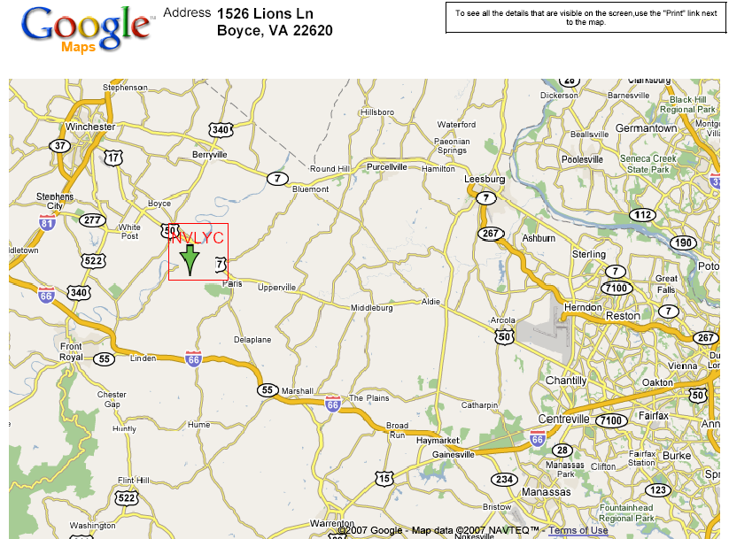
Where is NVLYC?

Slide 8
Northern Virginia Lions Youth Camp Board/Officers
Pres: Lion Ken Marr
1st VP: Lion Aron Hinson
2nd VP:PCC Wilma Murphy
Sec: Lion Evelyn Marr
Treas: Lion Mark Armendaris
Scheduler/Advisor: PCC Phil Schrack
District 24-L Cabinet Representatives
Lion Phil Mayo
PCC John Knepper
Director Reg I:
Director Reg II:
Director Reg III: Lion Phil Mayo
Director Reg IV: Lion Bill Poole
Director Reg V: PDG Sally Kenavan
Director Reg VI: Lion Scott Brown
Director Reg VII: Lion Greg Hart
Director Reg VIII: Lion Vickie Davis
IPP/ Senior Director: PID JAY Moughon
Senior Director Lion Sharon Schrack

Slide 10
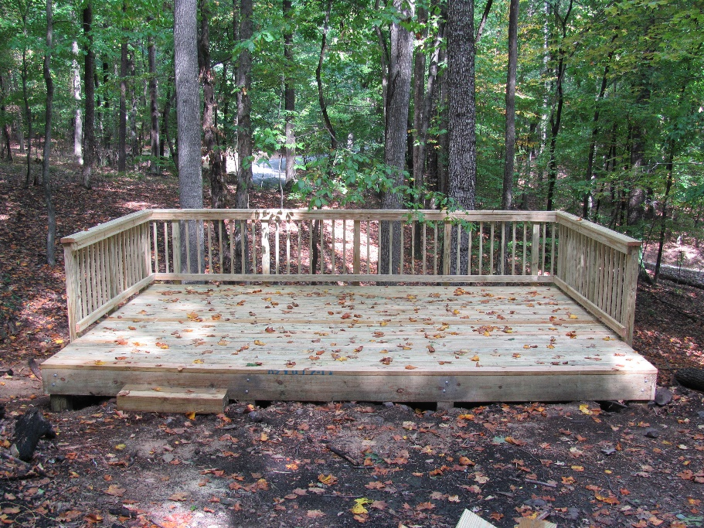
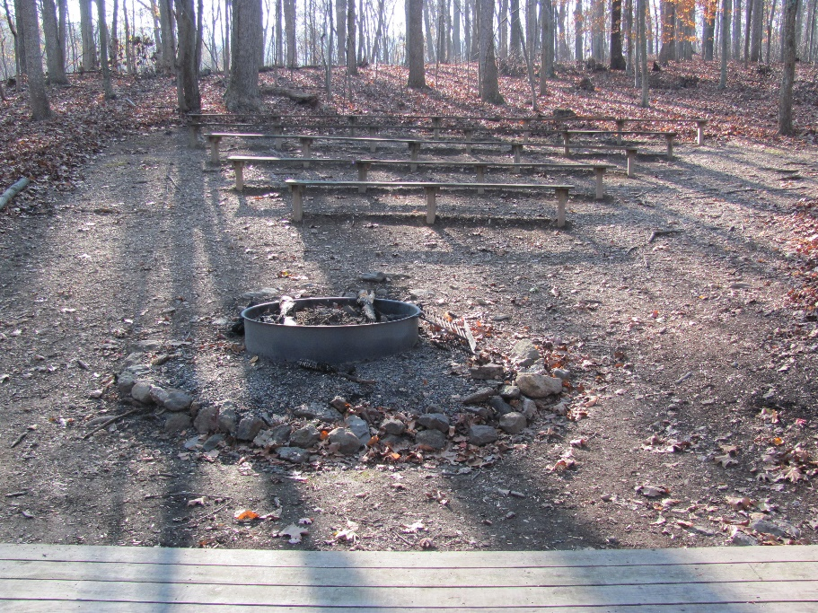
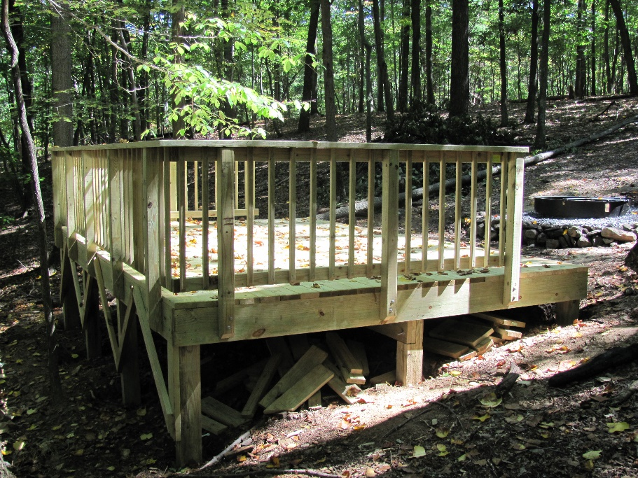
AMPHITHEATER
BUILT SEPTEMBER 2010
FALL 2024 BOY SCOUTS BUILT A WOOD STORAGE RACK

Slide 11
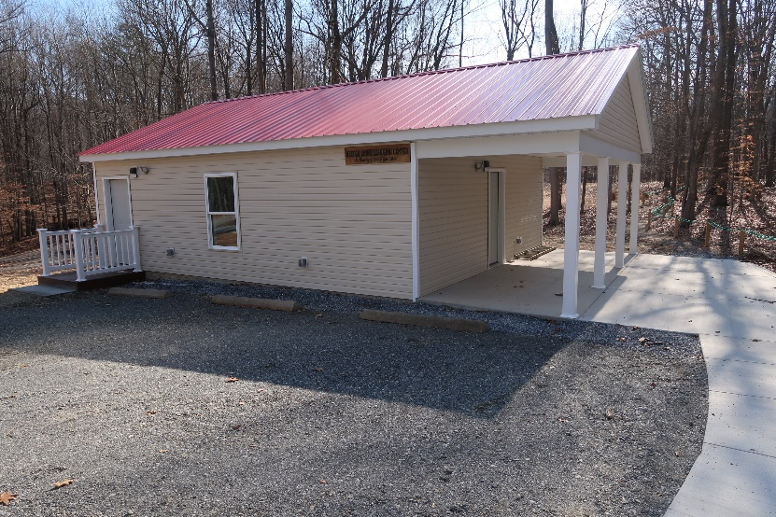
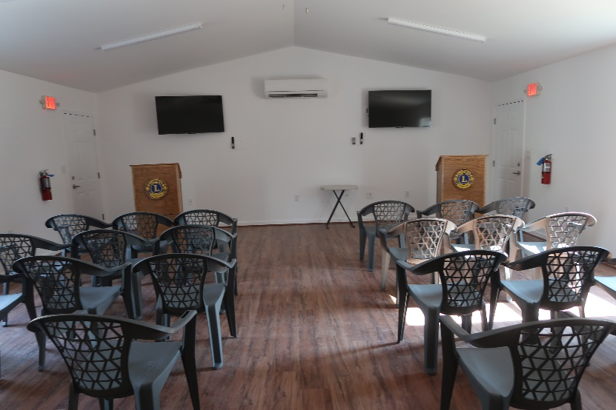
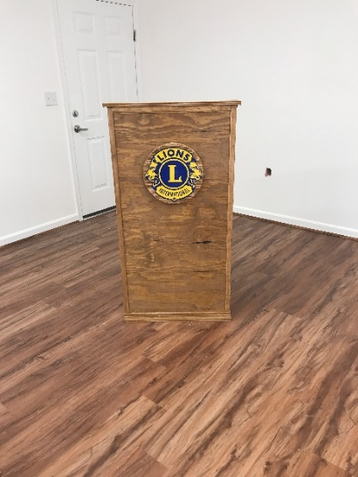
ARCOLA LEARNING CENTER
SIZE: 24 FT X 28 FT (672 SQUARE FEET)WITH AN 8 FT PORCH
NEAR DURANT HALL
SEATS 30 PEOPLE
SLEEPS 4
HEATED & A/C
2 PODIUMS (BUILT BY LION KEN MARR, NVLYC PRESIDENT)
2 TV FOR PRESENTATIONS
BUILT 2024

Slide 12
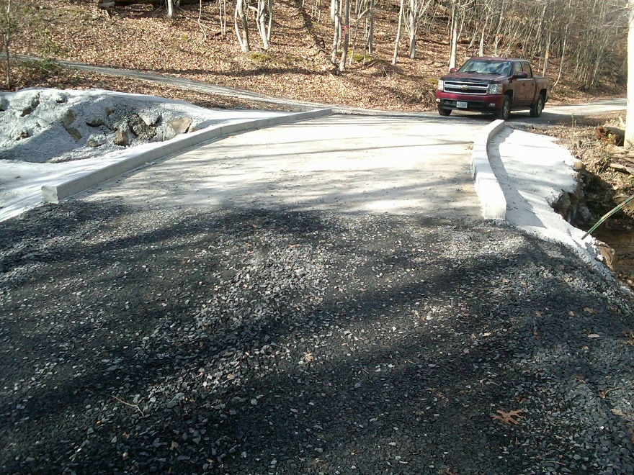
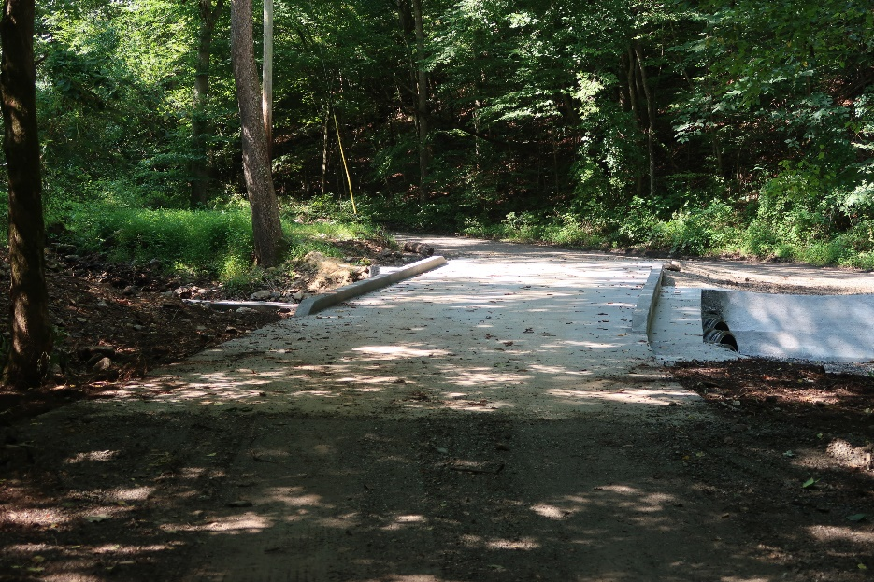
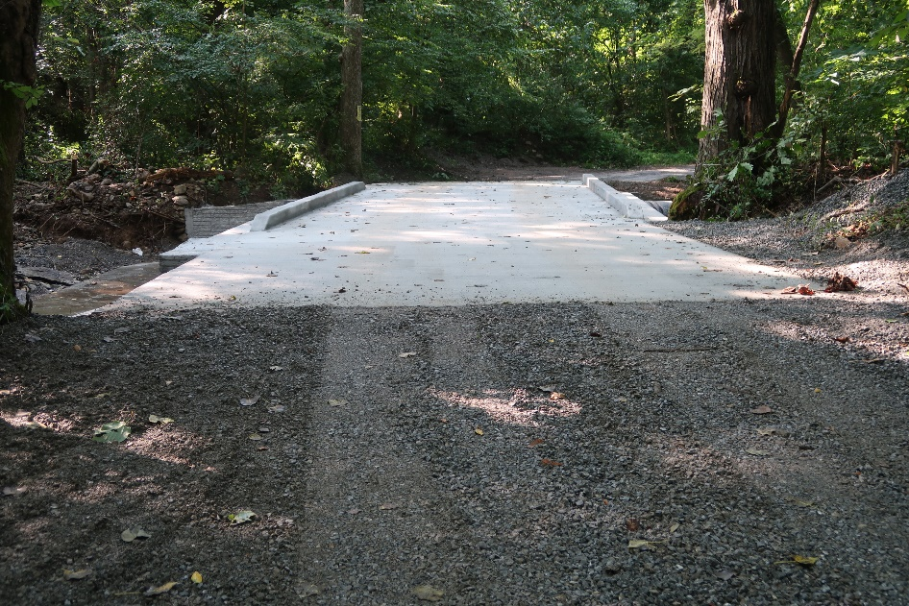
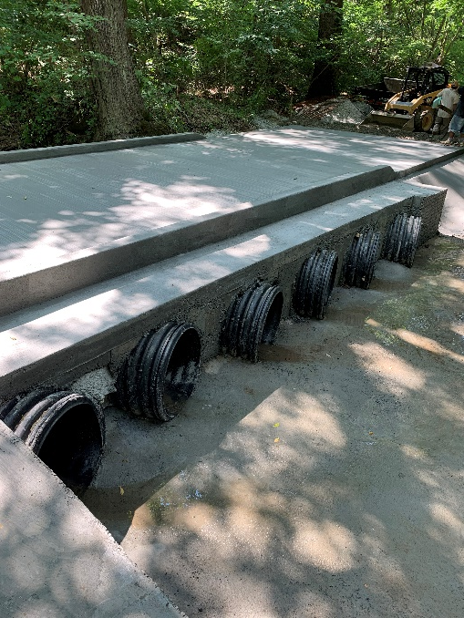
BRIDGES

Slide 13
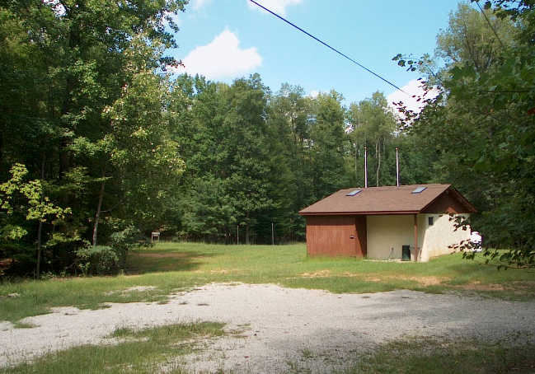
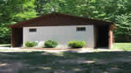
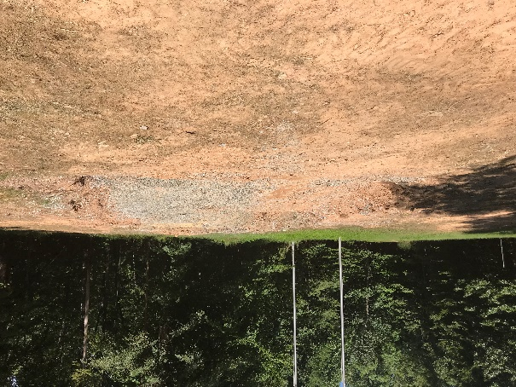
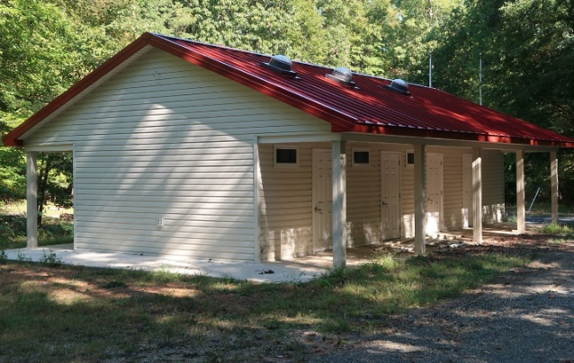
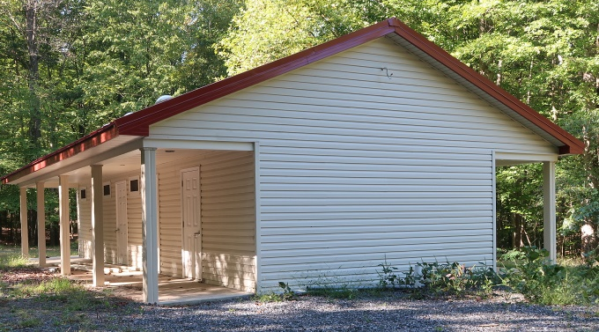
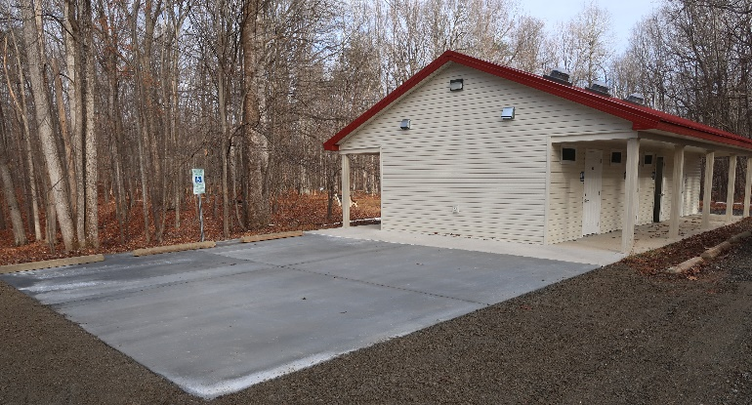
BATH HOUSE
BUILT 1988
DEMOLISHED 2023
REBUILT 2023

Slide 14
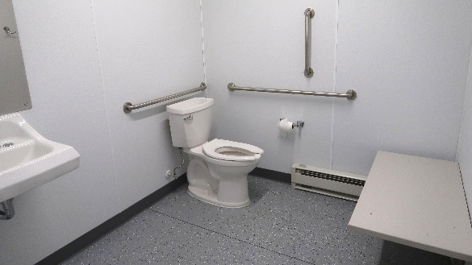
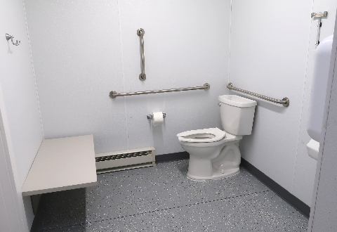
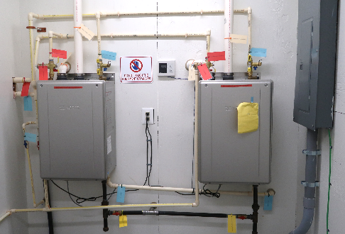
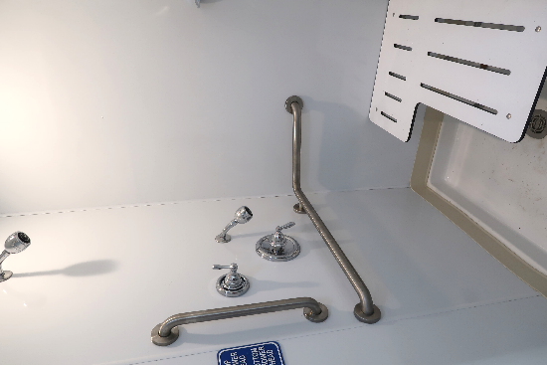
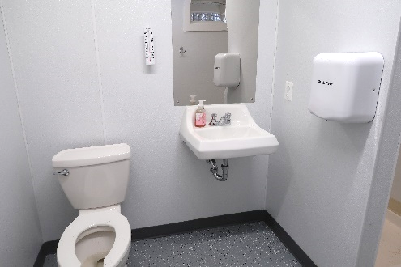
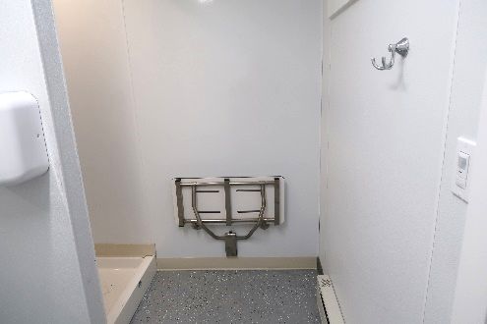
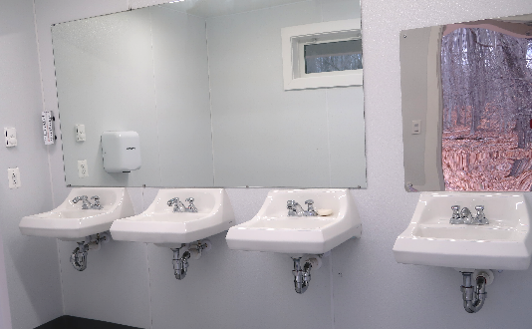
BATH HOUSE

Slide 15
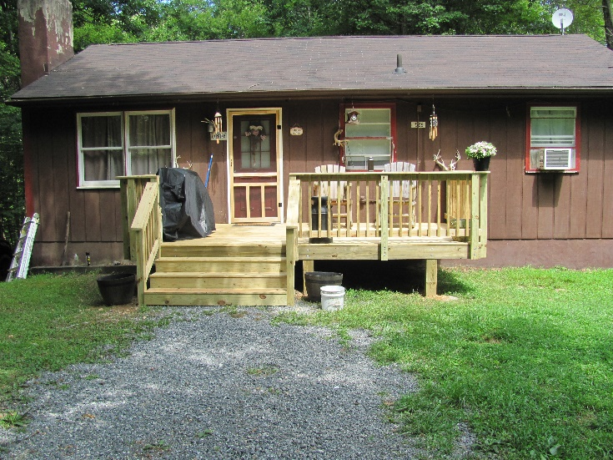
CARETAKER’S COTTAGE
BUILT 1984
Remodeled 2024
The interior
Installed a Heat Pump
2025 Plans to replace the siding, soffits, gutters, & downspouts

Slide 16
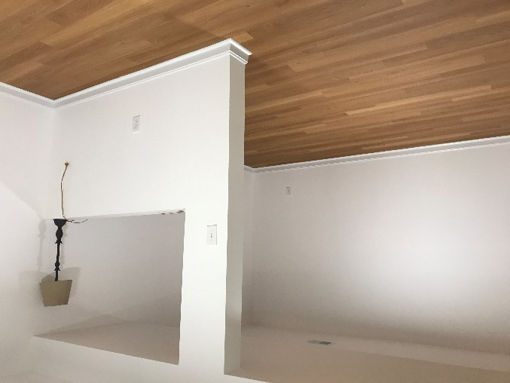
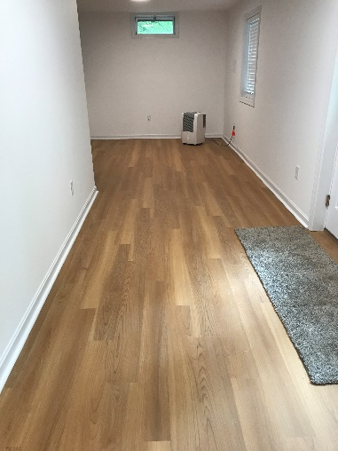
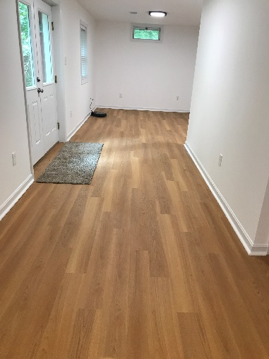
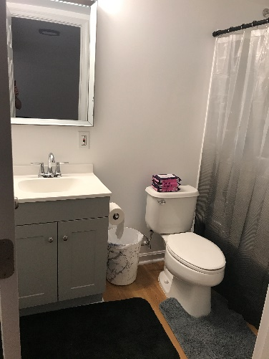
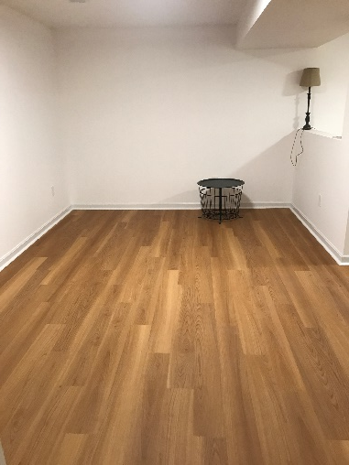
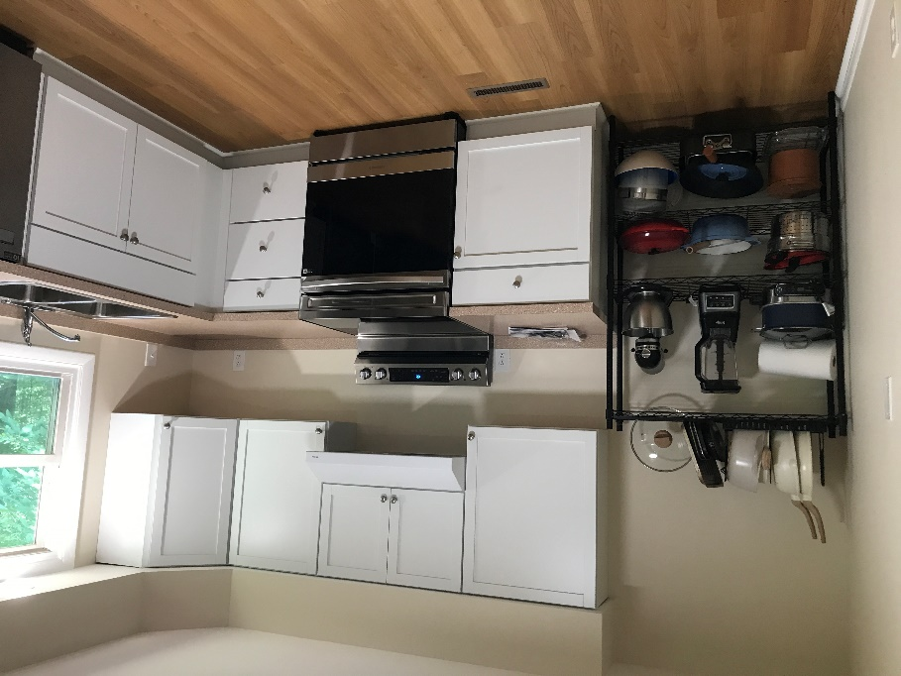
CARETAKER’S COTTAGE REMODLEING PICS

Slide 17
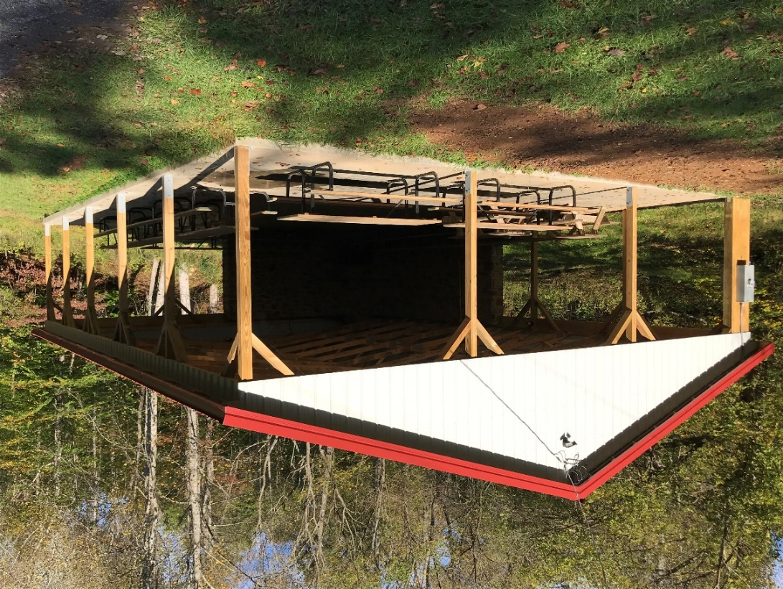
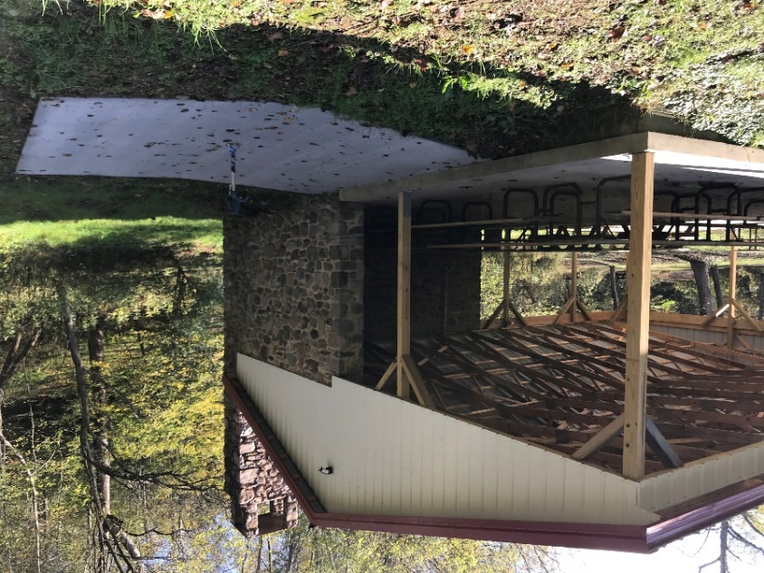
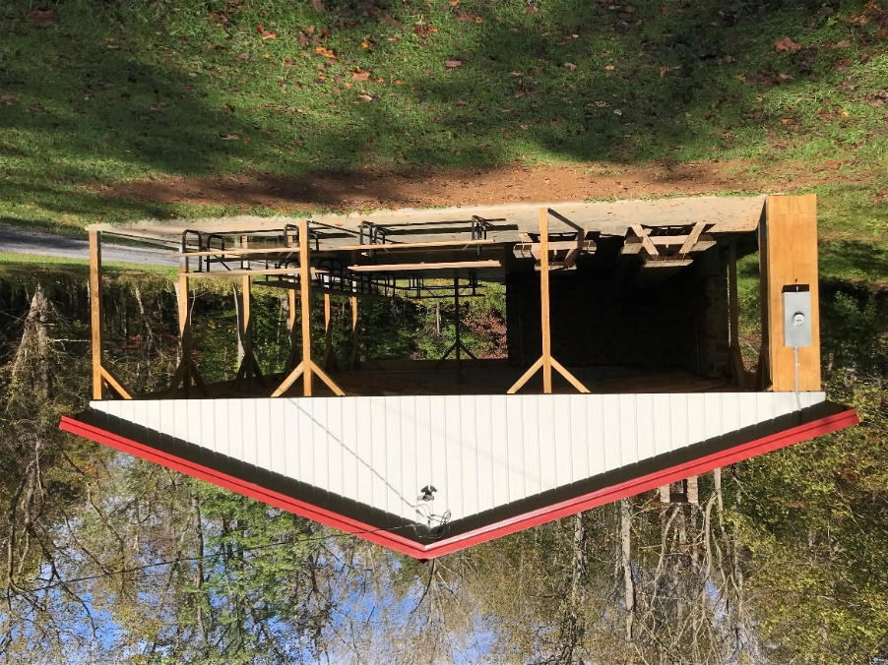
DAVIS PAVILION
BUILT 1967 – REMODELED 2017

Slide 18
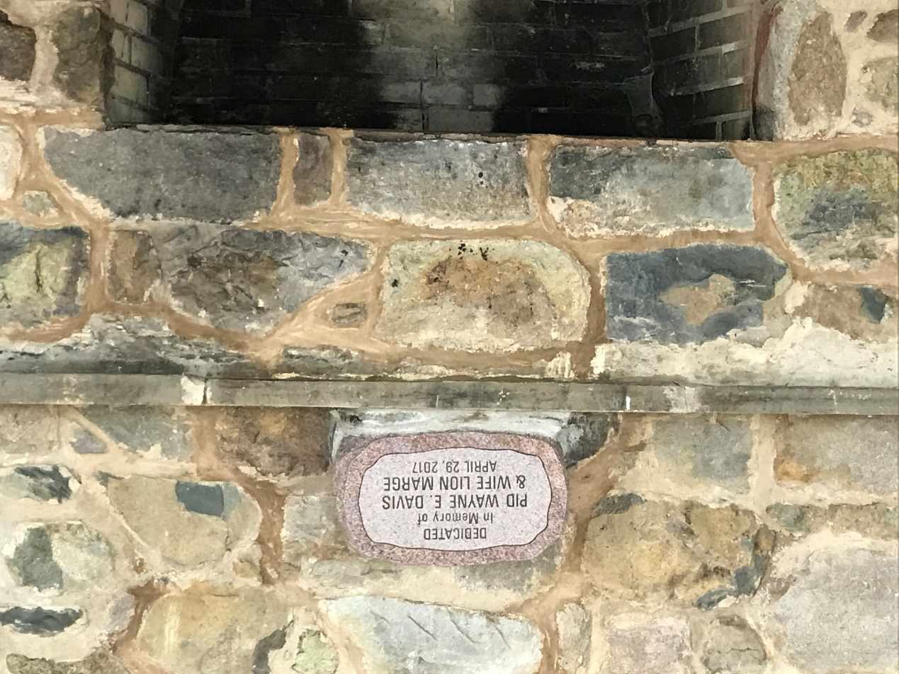
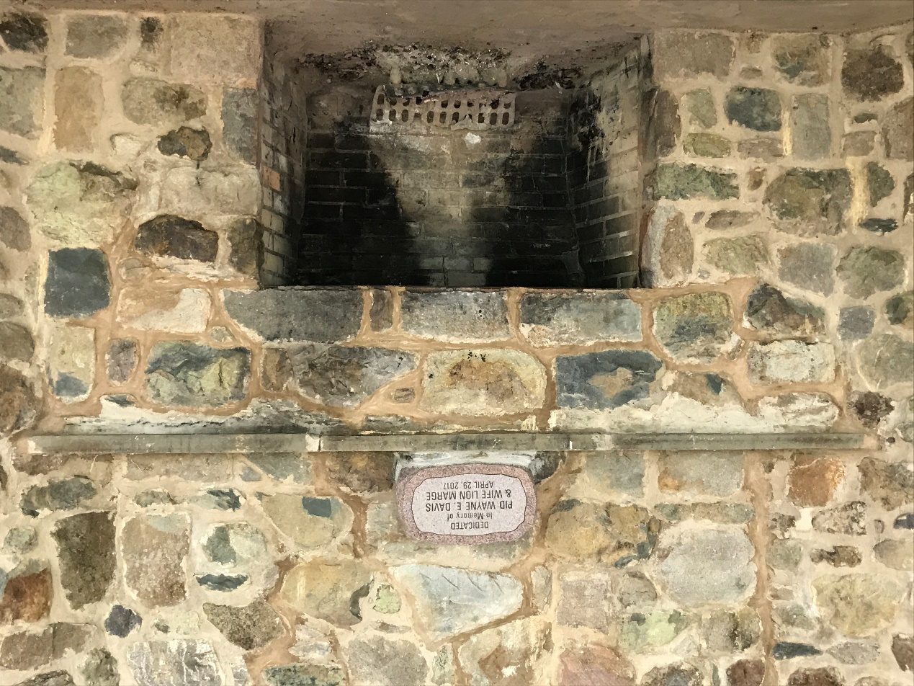
DAVIS PAVILION

Slide 19
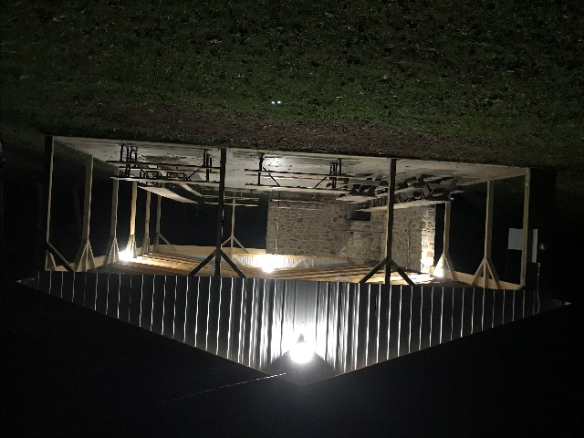
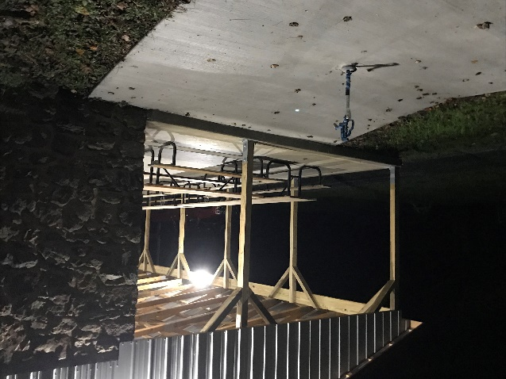
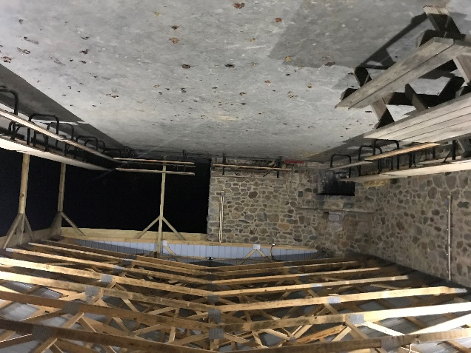
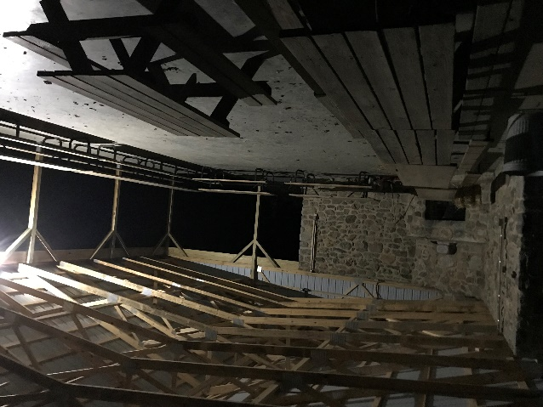
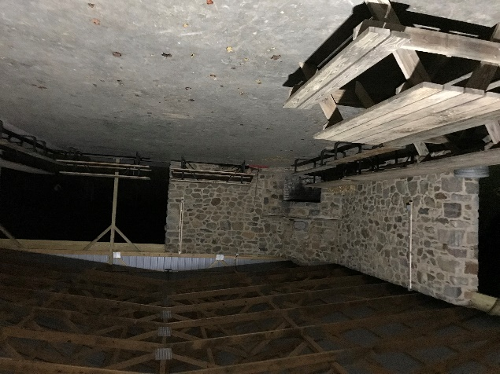
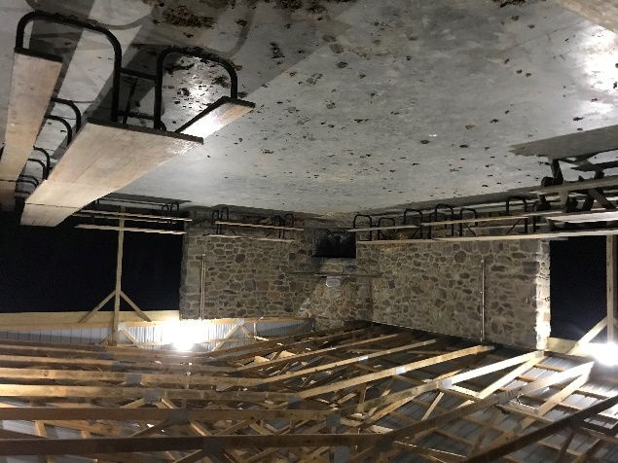
DAVIS PAVILION

Slide 20
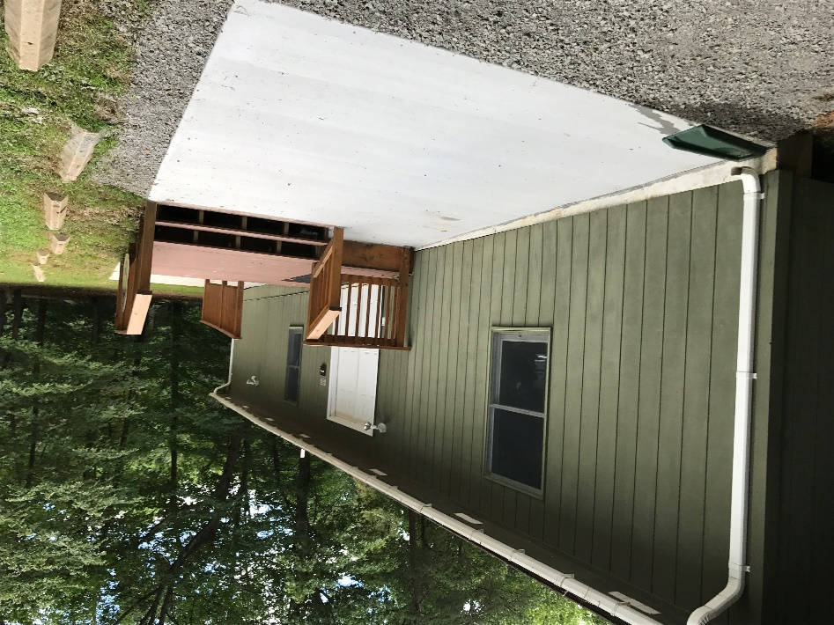
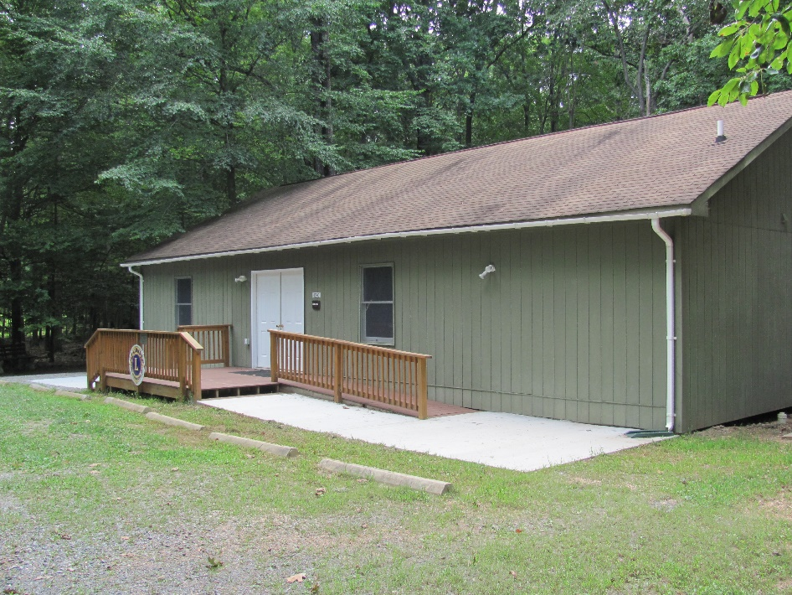
DURANT HALL
INSIDE WAS FINISHED 2002 REMODELED 2024

Slide 21
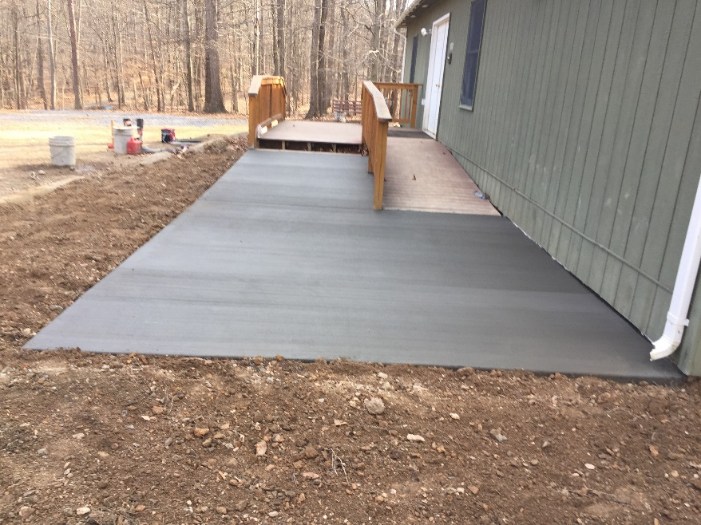
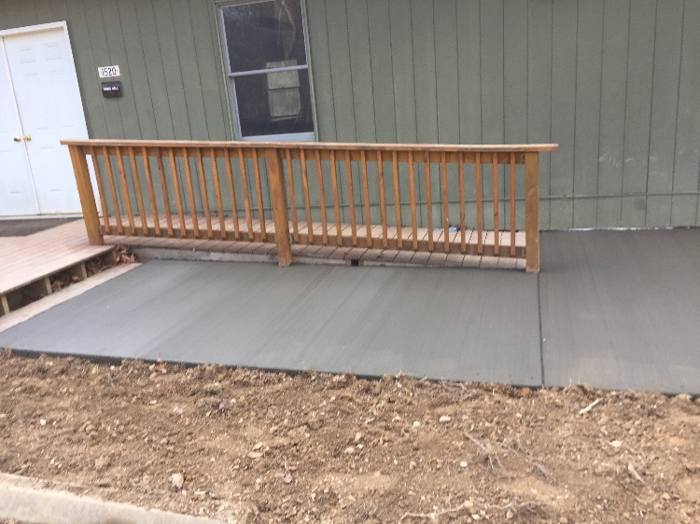
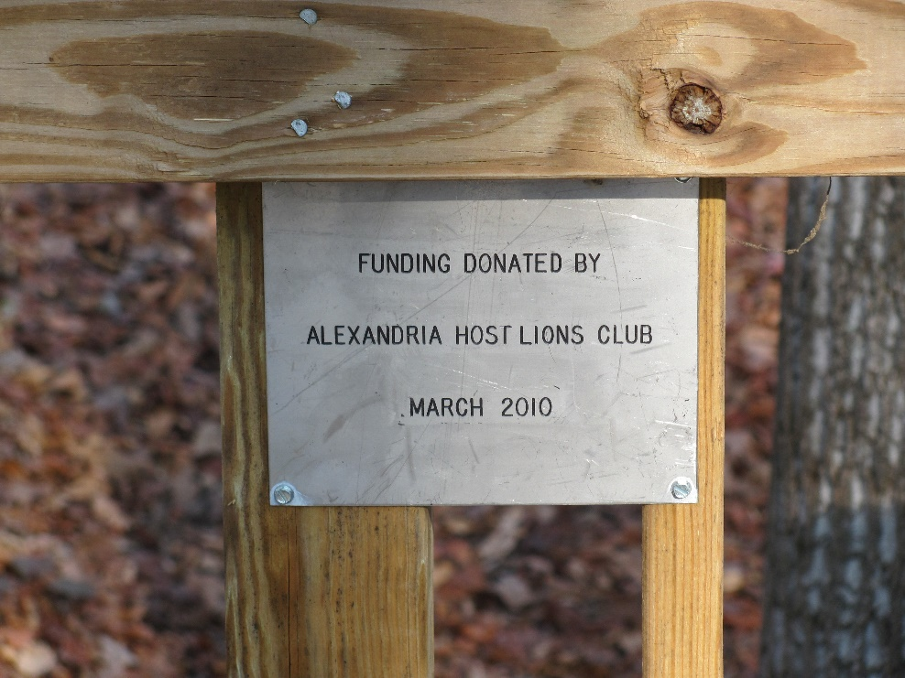
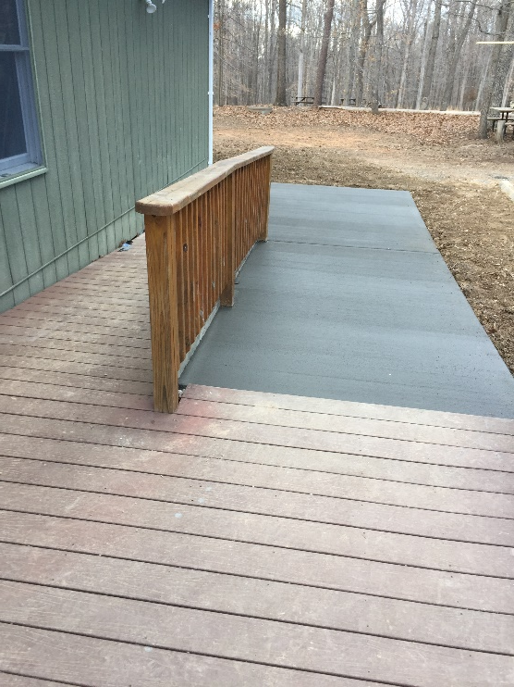

Slide 22
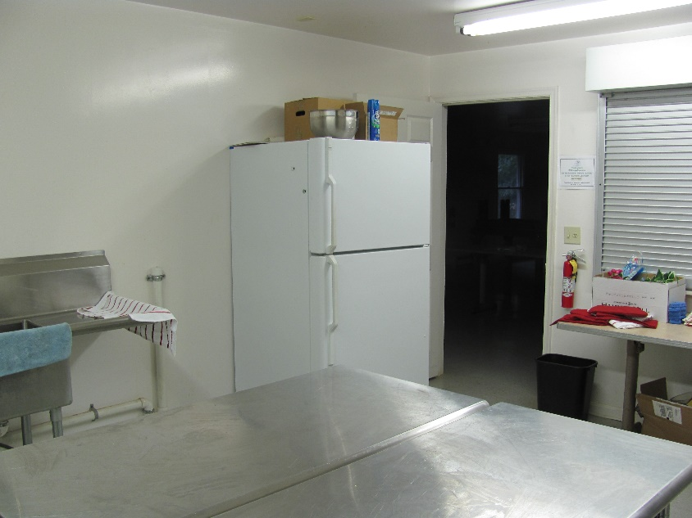
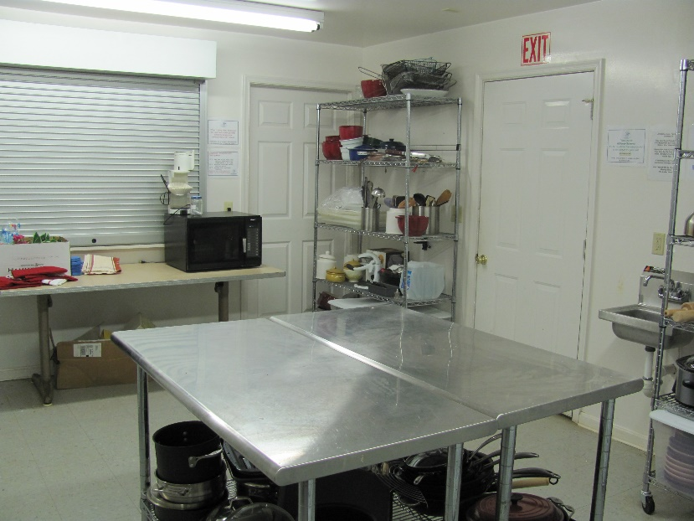
DURANT HALL

Slide 23
DURANT HALL FLOORING

Slide 24
CABINS TOTAL CABIN CAPACITY 122
BAILEYS CROSSROADS SLEEPS 18
CLIFTON SLEEPS 22
FAIRFAX HOST SLEEPS 12
BAILEYS CROSSROADS SLEEPS 18
ARCOLA LEARNING CENTER SLEEPS 4
PARK WEST SLEEPS 20

Slide 25
CABINS TOTAL CABIN CAPACITY 122
VIENNA HOST SLEEPS 18
WARRENTON SUNRISE SLEEPS 8
WOODBRIDGE SLEEPS 20

Slide 26
FAIRFAX HOST REMODELING
BUILT 1985
REPLACE WINDOWS
DOORS
CLOSED IN WIRING
INTERIOR FINISHING
REMOVE STOVE SMOKESTACK
GREAT JOB FAIRFAX HOST!!!!
REMODELED 2019

Slide 27
FAIRFAX & PARKWEST ADA RAMP

Slide 28
PARK WEST CABIN
BUILT 2007
REMODELED 2024

Slide 29
WARRENTON SUNRISE CABIN
WARRENTON SUNRISE
BUILT 2013

Slide 30
WOODBRIDGE REMODELING
REPLACE WINDOWS
DOORS
CLOSED IN WIRING
INTERIOR FINISHING
GREAT JOB WOODBRIDGE!!!!
BUILT 1996
REMODELED 2023

Slide 31
NVLYC USAGE BY FISCAL YEAR
# YEARS | Fiscal Year | Youth | Adults | Total
1 | 2003-2004 | 1824 | 887 | 2711
2 | 2004-2005 | 2008 | 906 | 2914
3 | 2005-2006 | 1332 | 681 | 2013
4 | 2006-2007 | 925 | 367 | 1292
5 | 2007-2008 | 1001 | 550 | 1551
6 | 2008-2009 | 1555 | 745 | 2300
7 | 2009-2010 | 1171 | 378 | 1549
8 | 2010-2011 | 1533 | 512 | 2045
9 | 2011-2012 | 756 | 367 | 1123
10 | 2012-2013 | 924 | 475 | 1399
11 | 2013-2014 | 944 | 437 | 1381
12 | 2014-2015 | 1643 | 716 | 2359
13 | 2015-2016 | 1394 | 633 | 2027
14 | 2016-2017 | 753 | 338 | 1091
15 | 2017-2018 | 658 | 453 | 1111
16 | 2018-2019 | 1121 | 519 | 1640
17 | 2019-2020 | 823 | 317 | 1166
18 | 2020-2021 | 764 | 315 | 1079
19 | 2021-2022 | 508 | 243 | 751
20 | 2022-2023 | 541 | 214 | 755
21 | 2023-2024 | 1161 | 540 | 1701
22 | 2024-2025* | 147 | 80 | 227
 | Total | 23486 | 10673 | 34185
 | 21 Year Average
 | Average | 1111 | 504 | 1617
* 22 Days/Weekends are booked for 2024-2025 (10/01/2024)
Estimated Total Campers for 2024-2025 is 1500

Slide 32
BOY SCOUTS EAGLE PROJECT

Slide 33
EXPENSES
OPERATION OF THE CAMP PER YEAR IS $45,000-$50,000/YEAR
REAL ESTATE TAXES
INSURANCE
DAILY MAINTENANCE
ROADS
UTILITIES
ELECTRICAL BILLS
TELEPHONE
WATER TESTING

Slide 34
FINANCES
INCOME
RENTALS
FEES $8.00/CAMPER/NIGHT
DURANT HALL (INCLUDED)
SECURITY DEPOSITES
CAMP $100.00
APPLIED TO CAMP RENTAL
DONATIONS/INCOME
CAMPERS
LIONS CLUBS
INDIVIDUALS
FUND RAISING

Slide 35
OPPORTUNITIES
WORK PROJECTS
APRIL 26, 2025
EARTH DAY
APRIL 26, 2025
OPEN HOUSE
APRIL 26, 2025

Slide 36
NVLYC INFORMATION
A CORPORTATION/FOUNDATION CHARTER IN THE COMMONWEALTH OF VIRGINIA
GOVERNED BY A BOARD OF DIRECTORS
501 _{C(3)} TAX EXEMPT

Slide 37
QUESTIONS
MY TIME IS UP AND I THANK YOU FOR YOURS!!

Slide 38
STOP!!!!

